Slide 1
Building and Maturing
your PSIRT
Lessons Learned from the trenches

Slide 2


Hello there!
Lisa Bradley, NVIDIA
CRob, Red Hat

Slide 3
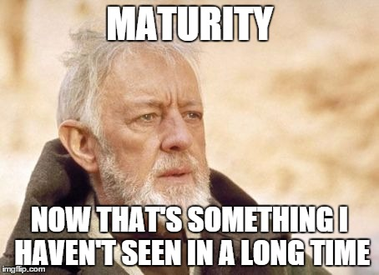
Agenda
Hi. We’re Lisa and CRob, and we’re here to talk to you about stuff and things…..
Characteristics of the Maturity Model
Novice PSIRT
Advanced PSIRT
Expert PSIRT
Agenda Point 3
Agenda Point 4

Slide 4
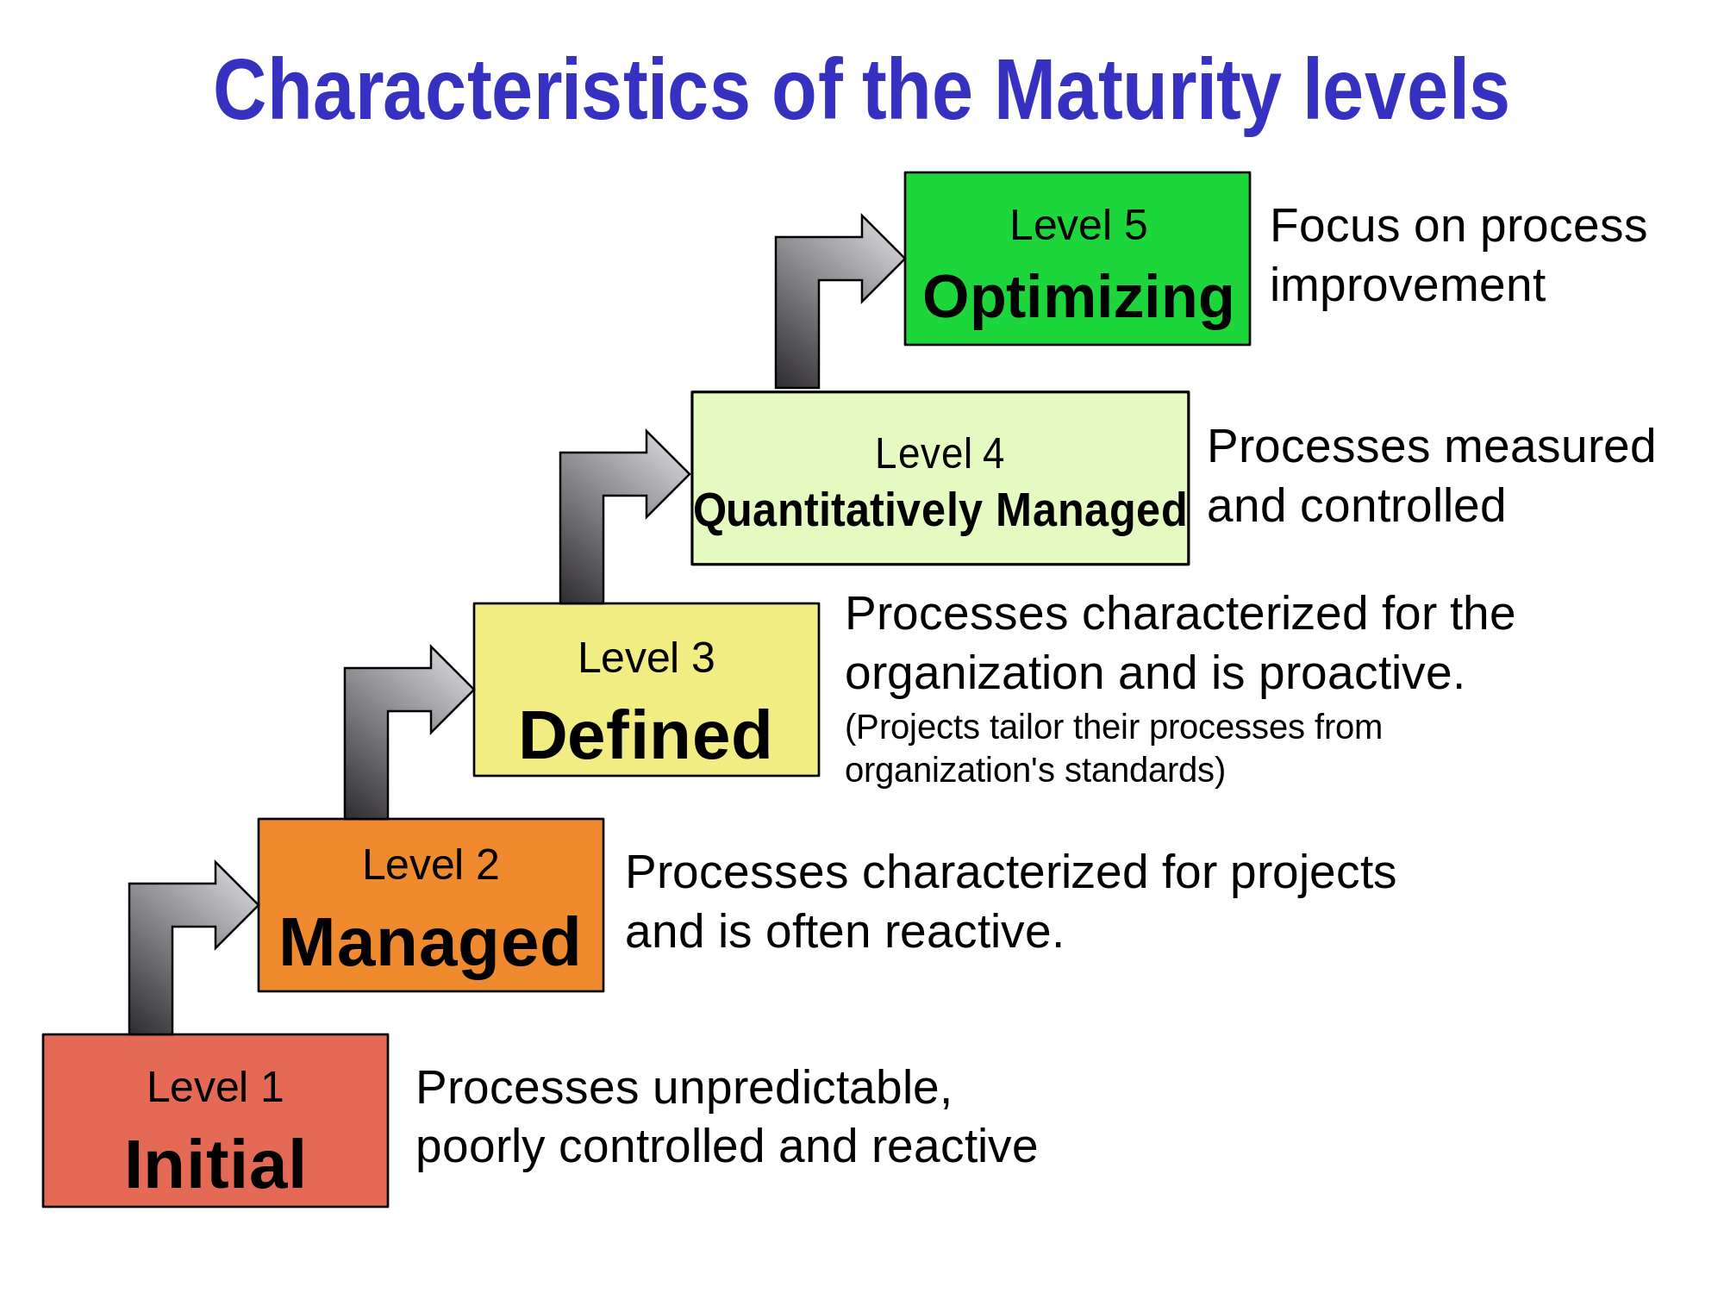
https://en.wikipedia.org/wiki/Capability_Maturity_Model_Integration

Slide 5
What will make you better is NOT new news
Process
People
Technology

Slide 6
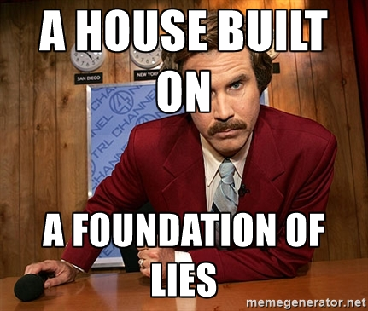
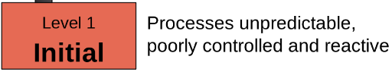
Novice
1
Let’s start with the beginning
Notes:
Initial - Organizational Foundations
I think this section would still jive
prioritizing what should be done first
basic PSIRT Process and what you minimally need to make that successful.

Slide 7
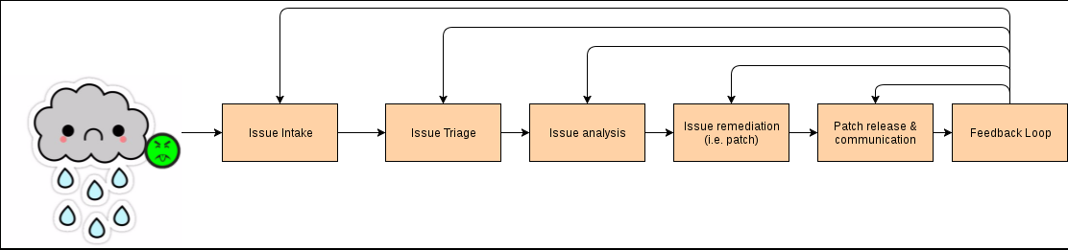
High level PSIRT Process steps
A High-level PSIRT process overview
Notes:
Feedback loop RCCA to dev’t for corrective action
RE: RCCA or whatever corrective action nomenclature feels appropriate. Speak to wherever your audience will meet you. The idea that PSIRT is not a closed process and extends (VALUE ADD) back into dev was what I was after.

Slide 8
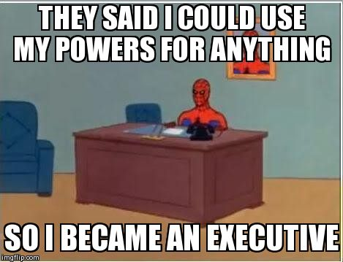
Executive and Organizational Support
The single most important thing a PSIRT needs is executive leadership buy-in and support. Without it, PSIRT will not be able to be effective in fulfilling its role.

Slide 9
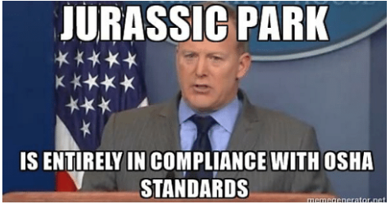
Using industry standards
Tools like CVE, CWE, CVSS, etc. are the common language that spans Products and Technologies and allows different organizations to understand

Slide 10

Ticketing/Tracking
Core to PSIRT operations, making the right choices up front will drive your process/workflow down the road…. Choose wisely
Can you leverage an existing bug system?

Slide 11
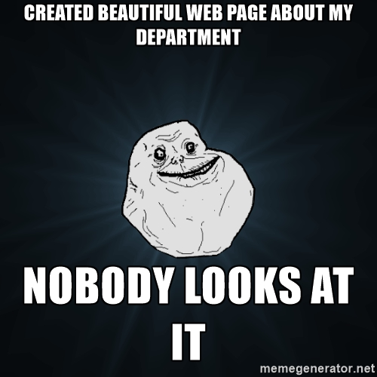
External Product Security Page
Customers and partners should have a simple way to see your processes/policies and be able to contact you.

Slide 12

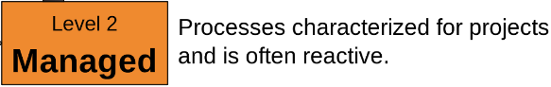
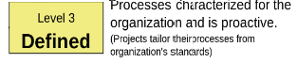
Advanced
2-3
Moving up the maturity scale
Notes:
What do you want to be when you grow up?
next steps such as creating an Expedited Process, date and version policies, and how to set up a team to support all the work.

Slide 13
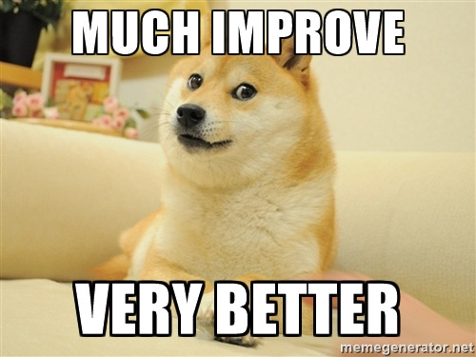
Maturity Improvement
What do we want to be when we grow ?
Once the basics are put into place and running smoothly, you’ll start thinking about how to improve things….

Slide 14
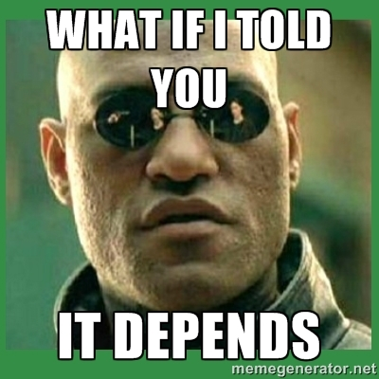
Dealing with 3rd party reporters
Odds are someone that isn’t you will find flaws in your products...how are you going to work with them?
Notes:
2 - Executive support
2 - Branch/Version Support Policies
2 - Exception process
2 - Dealing with 3rd party reporters
2 - Product Registry
2 - BU Security/PSIRT PICs - Cross organization support - Security Champions
1-2 Date Policies
2/3 - Embargoed - who and why (OEMs)
2/3 - Educating

Slide 15

Security Champion
Extending your team - Security Champions
Helps lead security activities
Develops security strategies and processes
Helps to evaluate issues
Reviews exceptions to policies
Scores vulnerabilities
Proactively monitors security
Notes:
Helps lead security activities
Develops security strategies and processes
Helps team to evaluate vulnerabilities
Reviews exceptions to policies
Scores issues
Proactively monitors security sites

Slide 16
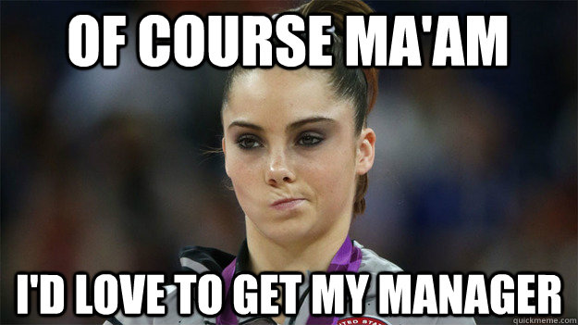
Policies and Lifecycles
It’s important to have
Branch/Version Support Policies
Date Policy - Delivery SLA
Exception process
Lifecycles
Documented for customers and employees
In the middle of one isn’t the best time to figure that out

Slide 17

Metrics
Active reporting:
Count by BU and source
Aging for each BU
Fixed issues reporting:
Count by source
Time to fix by source and BU
Other:
Exception stats
CWE for fixed issues
Consider audience for your metrics
Notes:
Metrics – I would emphasize making the metrics meaningful to the “senior leadership” you called out earlier. Raw bug count is often not meaningful. “Exposed units in the field for N days” probably reads better to many types. Consider the audience for your metrics so that they drive improvements.

Slide 18
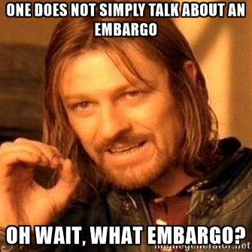
Embargos
Sometimes issues need to/are asked to be kept secret. How will you deal with it?
Is it in the best interest to the customer?
Notes:
When it’s in the best interest of the customer”. (NOT THE COMPANY, THE CUSTOMER!!!). If the conversation is revolving around the former, you’ve probably got it wrong. You can imagine how often the latter actually happens.

Slide 19
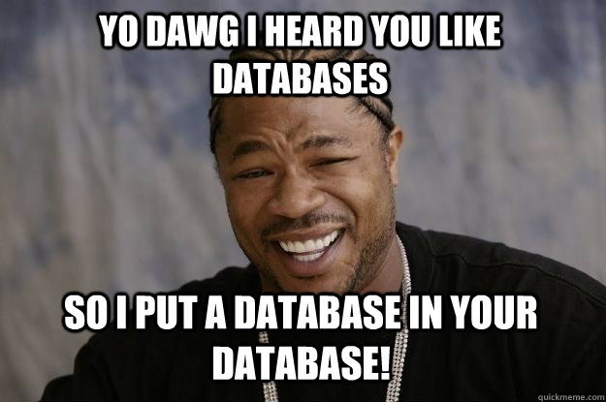
Maturity Improvement
Product Registry
Name and alias names
What are you?
Functional BU
More info:
Product lifecycle
Supported versions
Release schedule
Partners
Download page
OSS dependencies
Notes:
Name
Product/Cloud Offering/Platform/Component (if component list who consumes you)
Other alias names for product
Functional BU
Product Lifecycle link
Link to active/supported versions and what branch it relates to
Product Release Schedule link
OEM Partners, customers or both
Link to list of partners and/or customers
Public driver link
Private driver link

Slide 20

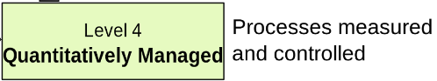
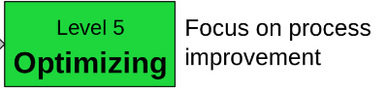
Expert
4-5
It really is all flying cars and silver spacesuits...
Notes:
The Future of PSIRTs

Slide 21
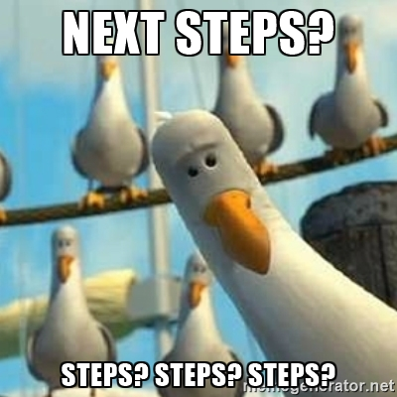
The Future of PSIRTs
So you’ve got a PSIRT, and you’ve got some process and tooling, you’re doing some stuff….what next?
Notes:
3 - Fully established Lifecycle
3-4 -OSS tooling Black Duck/WhiteSource/Palamida etc
3 - Dependency Management - Third Party Dependencies and Internal Dependencies
3 - Community internal support - helping each other
3 - External Groups FIRST
2/3 - Embargoed - who and why (OEMs)
3 - Alignment of security fixes for all versions/products
3 - Enhanced Severity definitions
3 / 4 - Operational, trends, broad level Metrics
2/3 - Educating
3- Integrating into SDLC
3- PSIRT Operations - having a real team (Minions)

Slide 22
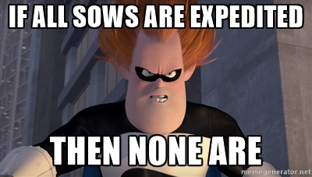
Advanced process and policies
Expedited Process
Whatever you call it, High Touch, Media events, Branded flaw, Expedited, yada yada… what do you plan to DO about it WHEN it happens?

Slide 23
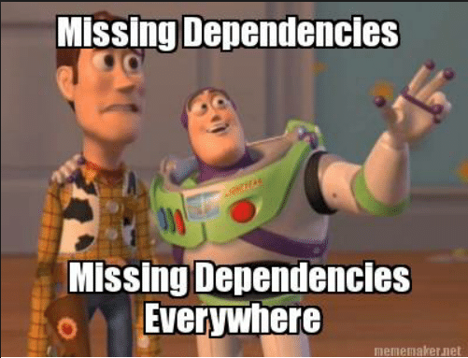
Dependency Management
Dependency Management
Do you really KNOW what’s inside your products?
How are you tracking what your devs are “baking in”?
What will you do when THEIR stuff breaks?
Notes:
Who are you getting into bed with?
Some things to think about
a. Do you have a process for handling internal or external dependencies?
b. How do you respond when a product you are dependent on (either internal or external) does not provide a fix? For example, do you communicate to customers that no fix is available?

Slide 24
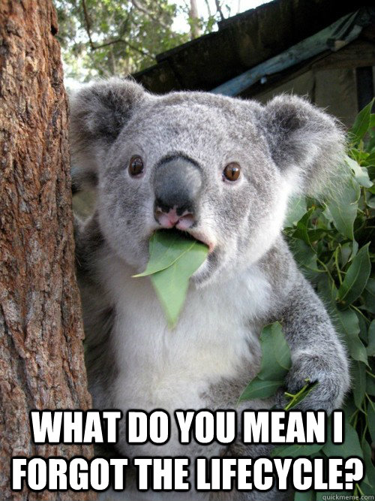
End-of-Lifecycle
Is it really a lifecycle if nothing ever dies?
Know thy Customers
DON’T LET SALES DEFINE YOUR LIFECYCLE!!!!!!!!!!!!!!!!!!!!!!!!!!!!!!!!
How are products EoL communicated?
Do you use a Phased approach?
When the lifecycle changes, what are you going to do? Can it change?
How are you managing “bundled” products?
Notes:
This is SDL as much as PSIRT.

Slide 25
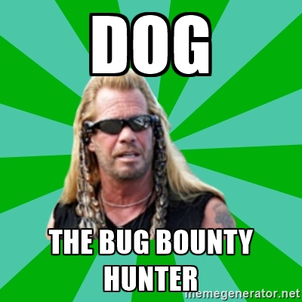
Will we ever get here?
Bug Bounties
This is a thing that exists. You may or may not elect to participate.
You will be contacted by people brokering vulns. What will you do?
B.B.’s do offer private services.
Notes:
5 - Hackerone/Bugcrowd - reaching to find issues bug bounty
Even if you’re not ready, don’t be afraid to look for other ways to “reward” contributors if you can’t do $$. Cultivate your ecosystem, they may be your best friends in the future.

Slide 26
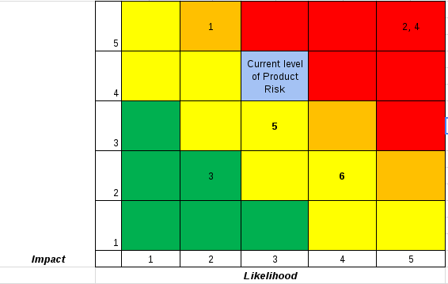
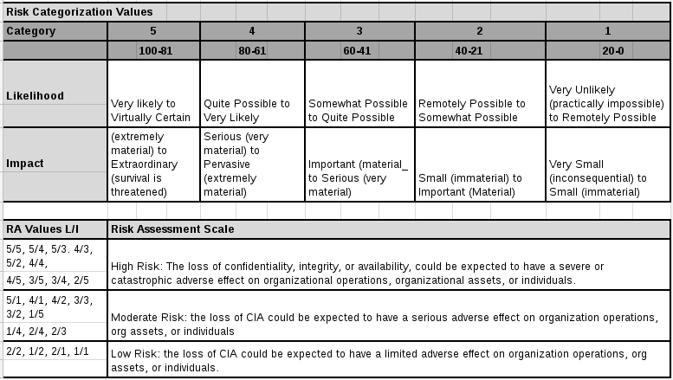
Advanced Risk Management
Using methods like STRIDE, threat modeling, risks matrixes, Options & Impacts, or others can help the PSIRT convey the level of Risk the organization is facing.
Once you get here, think about determining the costs of vulnerabilities & vuln mgmt.

Slide 27
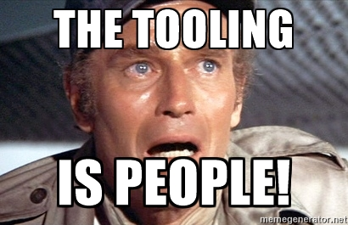
Advanced Tooling
PSIRT Tool
Scoring Tool
Feeding reporting/CWEs - feedback into Secure Engineering
Monitoring feeds and external sites - automatically pulling data from upstream sources to auto-generate a ticket (Dependency Tracking)

Slide 28
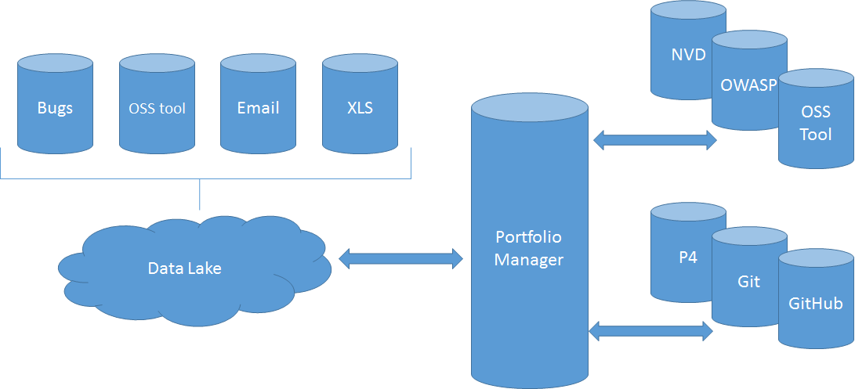
Portfolio Management System

Slide 29

To Summarize
Back to Basics…
Do this and that
Walk, then Crawl
Do that and this
Flying Cars
MOAR Awesomeness
Notes:
Basics Notes - defining high-level process, getting executive support
Crawl Notes - policies & extending your team with security champions
Flying cars notes - all roads lead here; dependency mgmt, expedited

Slide 30
THANKS!
Any questions?
You can find us at
www.linkedin.com/in/lisambradley and Lisa @ nvidia.com
@RedHatCRob and CRob @ RedHat.com

Slide 31

Appendix
Notes:
I think this section would still jive
prioritizing what should be done first
basic PSIRT Process and what you minimally need to make that successful.

Slide 32
Defining PSIRT Process, Steps
Email/submit/basic ticketing
Define Severity CVSS
CVE/CVSS industry standards
External Product Security Page
External Communication/Disclosure
Templates for Communication
Executive Support

Slide 33
Dealing with 3rd party reporters
Cross organization support - Security Champions
Branch/Version Support Policies
Date Policy - Delivery SLA
Exception process
Lifecycles
Baseline Metrics
Embargo
Product Registry
Educating

Slide 34
Community internal support - helping each other
External Groups FIRST
Alignment of security fixes for all versions/products
Enhanced Severity definitions
Integrating into SDLC
PSIRT Operations - having a real team

Slide 35
Expedited Process
OSS tooling
Dependency Management
Risk Management
Determine cost of vulnerability management
Operational, trends, broad level Metrics
Fully established Lifecycle
PSIRT Tool and Scoring Tool
Feeding reporting/CWEs - feedback into Secure Engineering (RCCA)
Monitoring feeds and external sites - automatically pulling data to auto-generate a ticket

Slide 36
Bug bounties - reaching to find issue

